Slide 1
Network models
Linear Programming and Optimization

Slide 2
Recall Types of Linear Programming
Allocation Models
Covering Models
Blending Models
Network Models

Slide 3
Recall Types of Linear Programming
Allocation Models
Covering Models
Blending Models
Network Models

Slide 4
Network Models
Network Models – models that describe the pattern of flow in a connected system
Nodes – system elements that are points in time and space
Arcs (edges) – paths of flow from one element/node to another
Notes:
Use brief bullets and discuss details verbally.

Slide 5
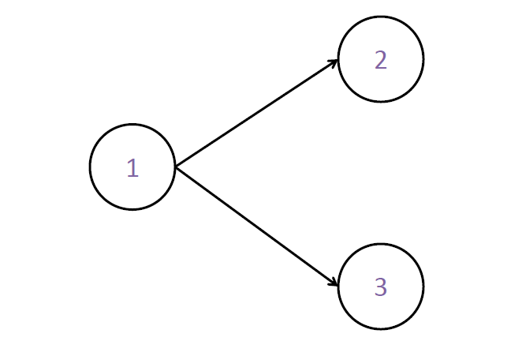
Example of a Network

Slide 6
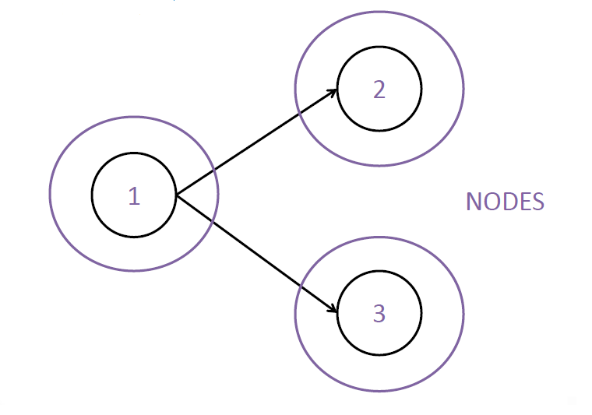
Example of a Network

Slide 7
Example of a Network
Arcs or Edges

Slide 8
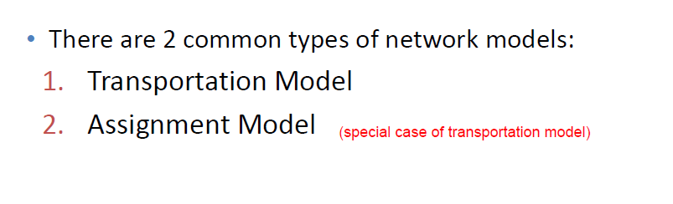
Types of Models
(Supply chain model optimizes how goods are shipped from suppliers to customers)

Slide 9
Transportation Model
You’ve seen this before!!

Slide 10
Transportation Model Example
Bonner Electronics
3 Manufacturing Plants (different capacities)
4 Distribution Warehouses (different demands)
Different costs between each shipping path combination
(No fixed costs)
Want to minimize cost

Slide 11
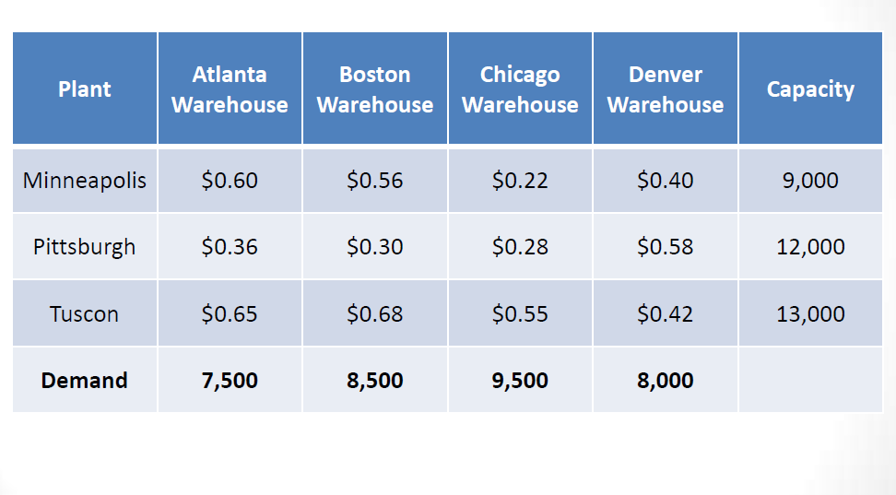
Transportation Model Example

Slide 12
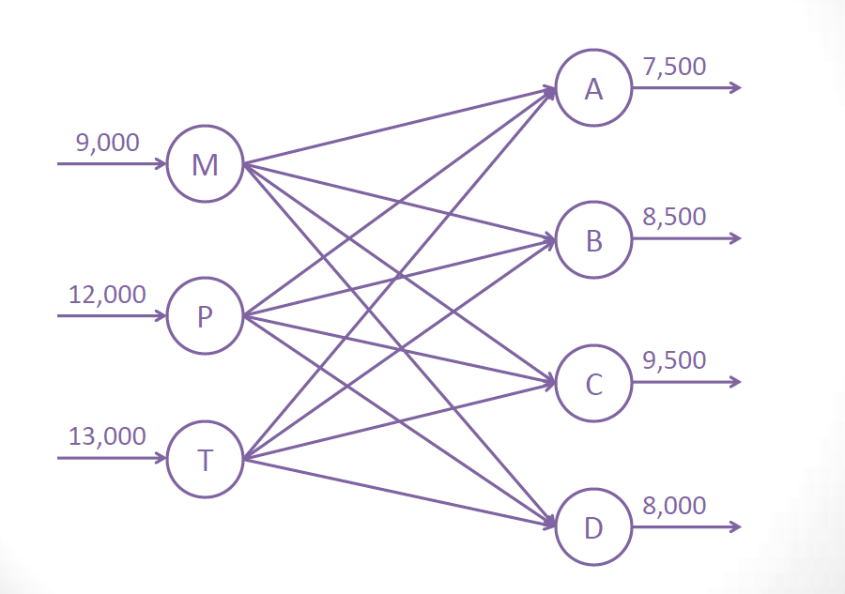
Transportation Model Example

Slide 13
SAS Code
proc optmodel;
set Warehouse = /Atlanta Boston Chicago Denver/;
set Plant = /Minneapolis Pittsburgh Tuscon/;
number ShipCost{Plant,Warehouse} = [0.60 0.56 0.22 0.40
0.36 0.30 0.28 0.58
0.65 0.68 0.55 0.42];
number Capacity{Plant} = [9000 12000 13000];
number Demand{Warehouse} = [7500 8500 9500 8000];
var x{Plant,Warehouse}>=0;
min Cost = sum{i in Plant}(sum{j in Warehouse}
(ShipCost[i,j]*x[i,j]));
con Cap {i in Plant}: sum{j in Warehouse} x[i,j] <= Capacity[i];
con Dem {j in Warehouse}: sum{i in Plant} x[i,j] >= Demand[j];
solve;
print x;
print x.rc;
print Cap.dual Dem.dual;
quit;

Slide 14
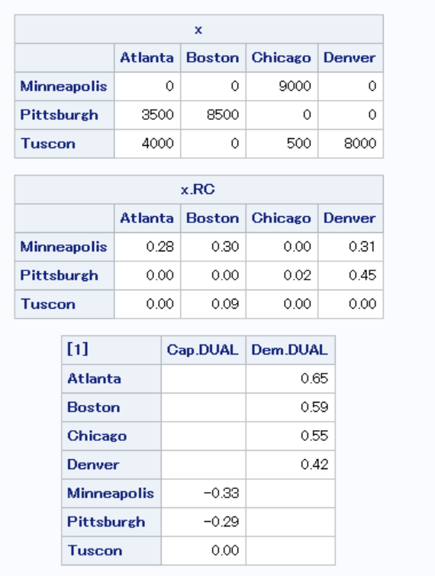
Output

Slide 15
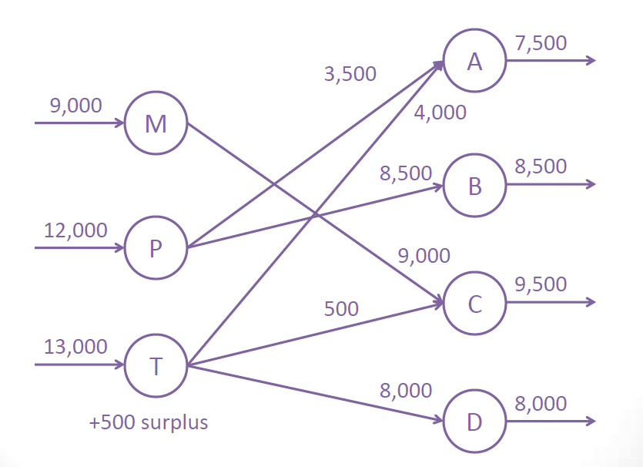

Slide 16
Rcode
library(lpSolve)
cost=matrix(c(.6,.36,.65,.56,.3,.68,.22,.28,.55,.4,.58,.42), ncol=4, byrow=F)
capacity=c(9000,12000,13000)
demand=c(7500,8500,9500,8000)
f.obj=as.numeric(cost)
f.con=matrix(0,nrow=7,ncol=12)
temp=c(1,4,7,10)
for (i in 1:3)
{f.con[i,(i-1+temp)]=1}
temp2=c(1,2,3)
for (i in 1:4)
{f.con[i+3,(3*(i-1)+temp2)]=1}
f.rhs=c(capacity,demand)
f.dir=c(rep('<=',3),rep('>=',4))
lp.model=lp (direction="min", f.obj, f.con, f.dir, f.rhs,compute.sens=1)
matrix(lp.model$solution,nrow=3,byrow=F)
matrix(lp.model$duals[8:19],nrow=3,byrow=F)

Slide 17
Output
> matrix(lp.model$solution,nrow=3,byrow=F)
[,1] [,2] [,3] [,4]
[1,] 0 0 9000 0
[2,] 3500 8500 0 0
[3,] 4000 0 500 8000
> matrix(lp.model$duals[8:19],nrow=3,byrow=F)
[,1] [,2] [,3] [,4]
[1,] 0.28 0.30 0.00 0.31
[2,] 0.00 0.00 0.02 0.45
[3,] 0.00 0.09 0.00 0.00

Slide 18
Gurobi
library(gurobi)
library(prioritizr)
cost=matrix(c(.6,.36,.65,.56,.3,.68,.22,.28,.55,.4,.58,.42), ncol=4, byrow=F)
capacity=c(9000,12000,13000)
demand=c(7500,8500,9500,8000)
model=list()
model$obj=as.numeric(cost)
model$A=matrix(0,nrow=7,ncol=12)
temp=c(1,4,7,10)
for (i in 1:3)
{model$A[i,(i-1+temp)]=1}
temp2=c(1,2,3)
for (i in 1:4)
{model$A[i+3,(3*(i-1)+temp2)]=1}
model$rhs=c(capacity,demand)
model$sense=c(rep('<=',3),rep('>=',4))
model$modelsense="min"
result=gurobi(model,list())
matrix(result$x,nrow=3,byrow=F)
matrix(result$rc,nrow=3,byrow=F)
result$pi

Slide 19
Output
> matrix(result$x,nrow=3,byrow=F)
[,1] [,2] [,3] [,4]
[1,] 0 0 9000 0
[2,] 3500 8500 0 0
[3,] 4000 0 500 8000
> matrix(result$rc,nrow=3,byrow=F)
[,1] [,2] [,3] [,4]
[1,] 0.28 0.30 0.00 0.31
[2,] 0.00 0.00 0.02 0.45
[3,] 0.00 0.09 0.00 0.00
> result$pi
[1] -0.33 -0.29 0.00 0.65 0.59 0.55 0.42

Slide 20
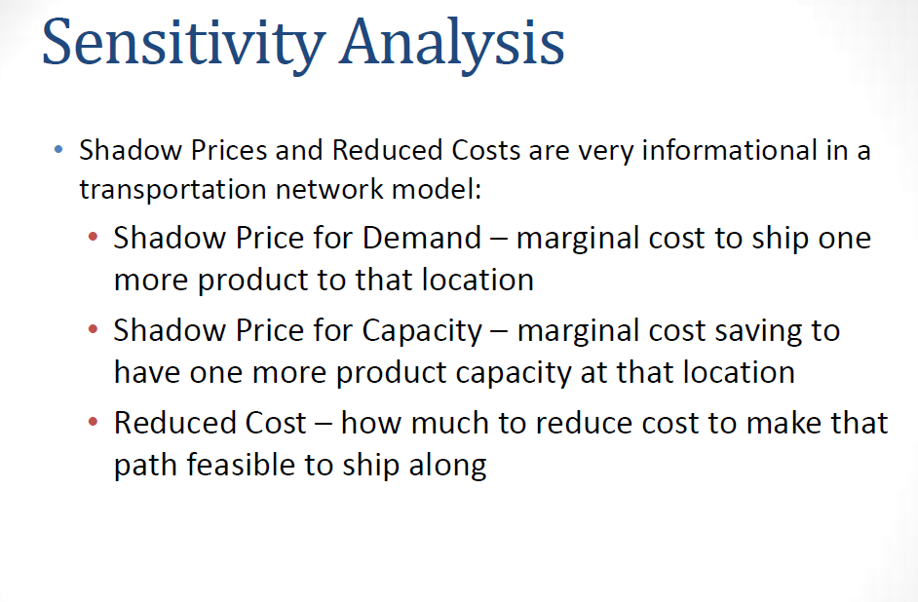

Slide 21
Assignment Model

Slide 22
Assignment Model Example
Buchanan Swim Club
Ned to assign 4 swimmers to the relay (4 strokes)
Have times for each person’s best of each stroke
Want to minimize relay time

Slide 23
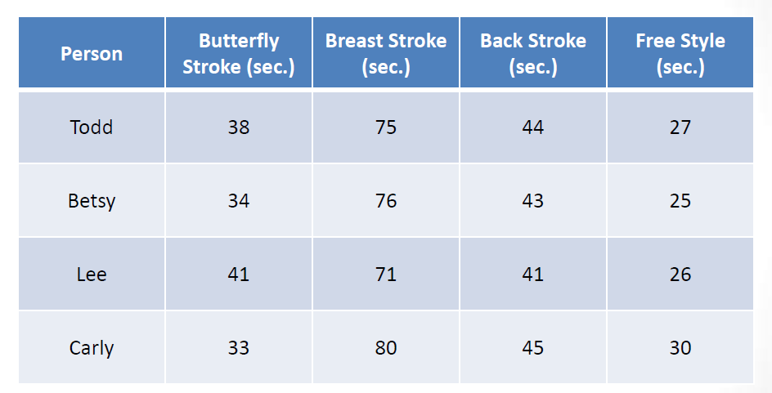
Assignment Model Example

Slide 24
SAS Code
proc optmodel;
set Stroke = /Butterfly Breaststroke Backstroke Freestyle/;
set Swimmer = /Todd Betsy Lee Carly/;
number Time{Swimmer,Stroke} = [38 75 44 27
34 76 43 25
41 71 41 26
33 80 45 30];
var x{Swimmer,Stroke}>=0 binary;
min RelayTime = sum{i in Swimmer}(sum{j in Stroke}
(Time[i,j]*x[i,j]));
con MaxSwimmer {i in Swimmer}: sum{j in Stroke} x[i,j] = 1;
con MaxStroke {j in Stroke}: sum{i in Swimmer} x[i,j] = 1;
solve;
print x;
quit;

Slide 25
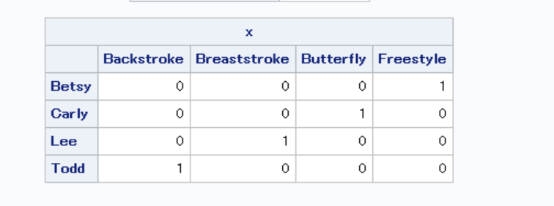
Output

Slide 26
Rcode
time=matrix(c(38,34,41,33,75,76,71,80,44,43,41,45,27,25,26,30),nrow=4,byrow=F)
f.obj=as.numeric(time)
f.con=matrix(0,nrow=8,ncol=16)
temp=c(1,5,9,13)
for (i in 1:4)
{f.con[i,(i-1+temp)]=1}
temp2=c(1,2,3,4)
for (i in 1:4)
{f.con[i+4,(4*(i-1)+temp2)]=1}
f.rhs=rep(1,8)
f.dir=rep('=',8)
lp.model=lp (direction="min", f.obj, f.con, f.dir, f.rhs)
matrix(lp.model$solution,nrow=4,byrow=F)
lp.model$objval

Slide 27
Output
> matrix(lp.model$solution,nrow=4,byrow=F)
[,1] [,2] [,3] [,4]
[1,] 0 0 1 0
[2,] 0 0 0 1
[3,] 0 1 0 0
[4,] 1 0 0 0
> lp.model$objval
[1] 173

Slide 28
Gurobi
time=matrix(c(38,34,41,33,75,76,71,80,44,43,41,45,27,25,26,30),nrow=4,byrow=F)
model=list()
model$obj=as.numeric(time)
model$A=matrix(0,nrow=8,ncol=16)
temp=c(1,5,9,13)
for (i in 1:4)
{model$A[i,(i-1+temp)]=1}
temp2=c(1,2,3,4)
for (i in 1:4)
{model$A[i+4,(4*(i-1)+temp2)]=1}
model$rhs=rep(1,8)
model$sense=rep('=',8)
model$modelsense="min"
result=gurobi(model,list())
matrix(result$x,nrow=4,byrow=F)
result$objval

Slide 29
Output
> matrix(result$x,nrow=4,byrow=F)
[,1] [,2] [,3] [,4]
[1,] 0 0 1 0
[2,] 0 0 0 1
[3,] 0 1 0 0
[4,] 1 0 0 0
> result$objval
[1] 173

Slide 30
Transshipment Model

Slide 31
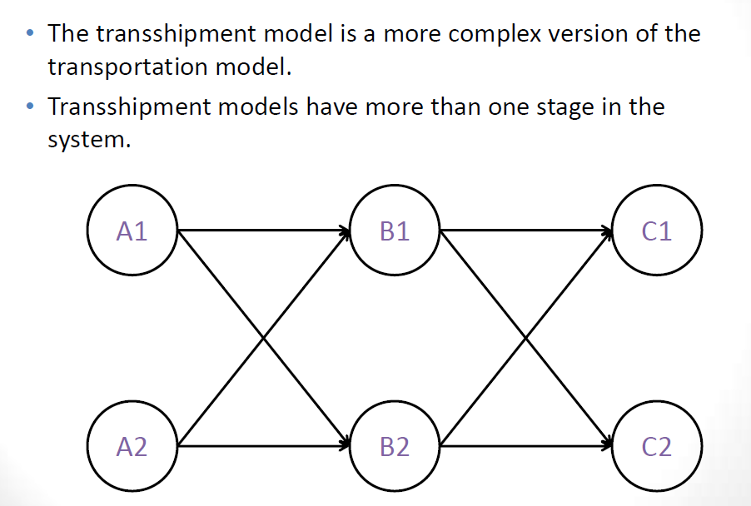
Transshipment Model

Slide 32
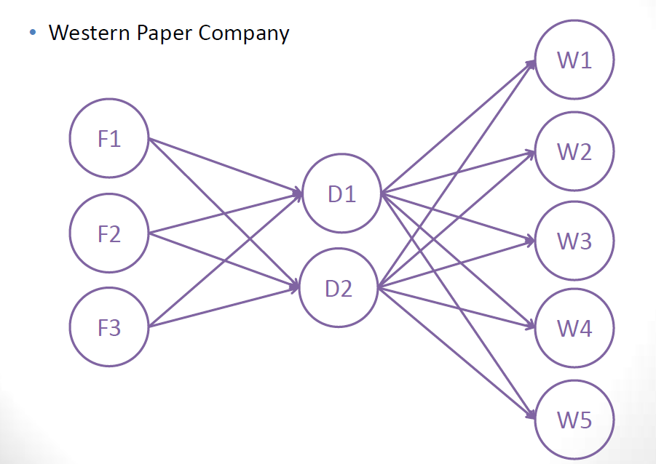
Transshipment Model Example

Slide 33
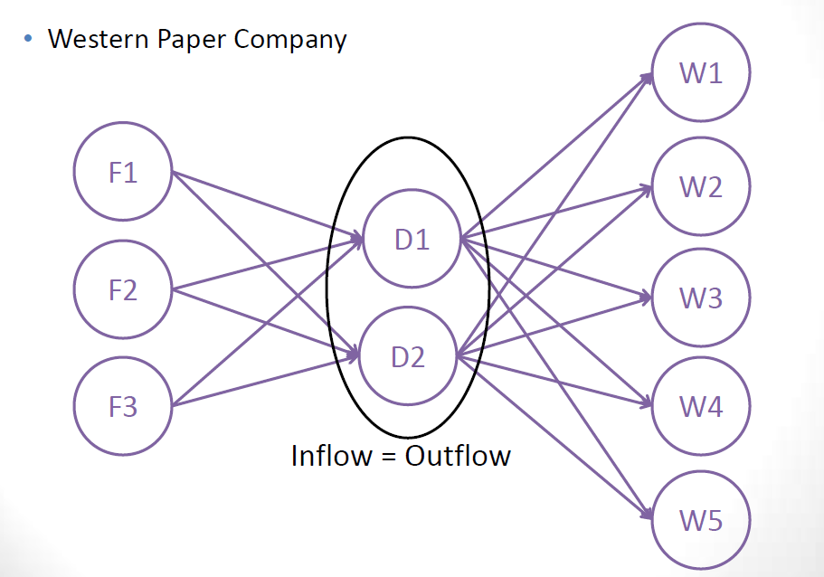
Transshipment Model Example

Slide 34
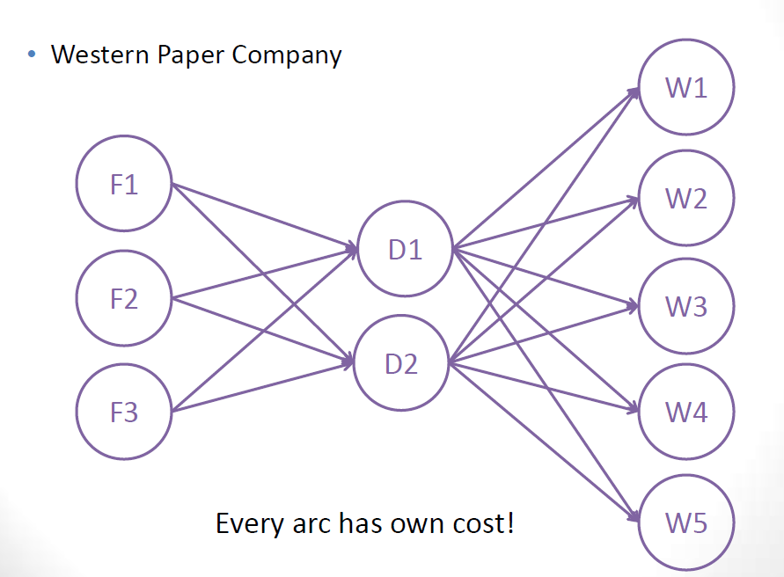
Transshipment Model Example

Slide 35
proc optmodel;
set Factory = /Fac1 Fac2 Fac3/;
set DistCenter = /Dist1 Dist2/;
set Warehouse = /Ware1 Ware2 Ware3 Ware4 Ware5/;
number F2DCost{Factory,DistCenter} = [1.28 1.36 1.33 1.38 1.68 1.55];
number D2WCost{DistCenter,Warehouse} = [0.60 0.42 0.32 0.44 0.68
0.57 0.30 0.4 0.38 0.72];
number Demand{Warehouse} = [1200 1300 1400 1500 1600];
var F2D{Factory,DistCenter}>=0,
D2W{DistCenter,Warehouse}>=0;
min Cost = sum{i in Factory}(sum{j in DistCenter}(F2DCost[i,j]*F2D[i,j])) +
sum{k in DistCenter}(sum{l in Warehouse}(D2WCost[k,l]*D2W[k,l]));
con Cap {i in Factory}: sum{j in DistCenter} F2D[i,j] <= 2500;
con Dem {j in Warehouse}: sum{i in DistCenter}
D2W[i,j] >= Demand[j];
con Cons {j in DistCenter}: sum{k in Warehouse}D2W[j,k] -
sum{i in Factory}F2D[i,j] = 0;
solve;
print F2D D2W;
print F2D.rc D2W.rc;
quit;

Slide 36
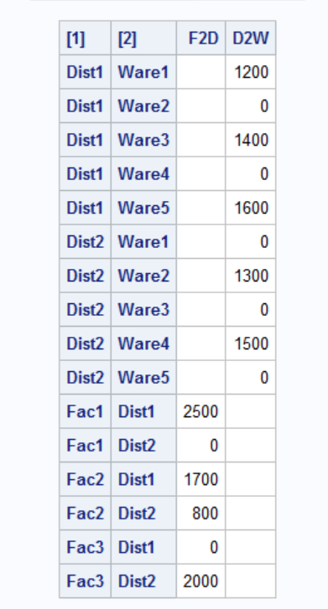
Output

Slide 37
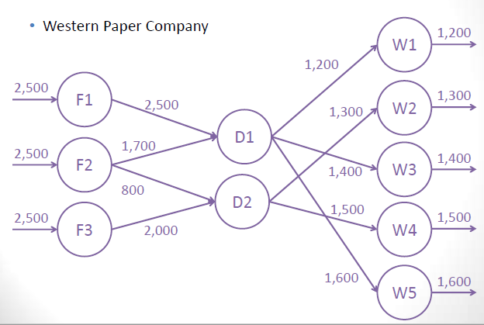
Transshipment Model Example

Slide 38
R Code
f2dcost=matrix(c(1.28,1.36,1.33,1.38,1.68,1.55),nrow=3,byrow=T)
d2wcost=matrix(c(0.6,0.42,0.32,0.44,0.68,0.57,0.3,0.4,0.38,0.72),nrow=2,byrow=T)
demand=c(1200,1300,1400,1500,1600)
f.obj=c(as.numeric(f2dcost),as.numeric(d2wcost))
f.con=matrix(0,nrow=10,ncol=16)
for (i in 1:3)
{f.con[i,i]=1
f.con[i,i+3]=1}
for (i in 1:5)
{f.con[i+3,6+2*i-1]=1
f.con[i+3,6+2*i]=1}
temp=c(7,9,11,13,15)
temp2=c(8,10,12,14,16)
f.con[9,temp]=1
f.con[9,1:3]=-1
f.con[10,temp2]=1
f.con[10,4:6]=-1
f.rhs=c(rep(2500,3),demand,0,0)
f.dir=c(rep('<=',3),rep('>=',5),'=','=')
lp.model=lp (direction="min", f.obj, f.con, f.dir, f.rhs)
first.lp=matrix(result$x[1:6],nrow=3,byrow=F)
rownames(first.lp)=c('Fac1','Fac2','Fac3')
colnames(first.lp)=c('Dist1','Dist2')
first.lp
second.lp=matrix(result$x[7:16],nrow=2,byrow=F)
rownames(second.lp)=c('Dist1','Dist2')
colnames(second.lp)=c('Ware1','Ware2','Ware3','Ware4','Ware5')
second.lp

Slide 39
Output
> first.lp
Dist1 Dist2
Fac1 2500 0
Fac2 1700 800
Fac3 0 2000
> second.lp
Ware1 Ware2 Ware3 Ware4 Ware5
Dist1 1200 0 1400 0 1600
Dist2 0 1300 0 1500 0

Slide 40
Gurobi
f2dcost=matrix(c(1.28,1.36,1.33,1.38,1.68,1.55),nrow=3,byrow=T)
d2wcost=matrix(c(0.6,0.42,0.32,0.44,0.68,0.57,0.3,0.4,0.38,0.72),nrow=2,byrow=T)
demand=c(1200,1300,1400,1500,1600)
model=list()
model$obj=c(as.numeric(f2dcost),as.numeric(d2wcost))
model$A=matrix(0,nrow=10,ncol=16)
for (i in 1:3)
{model$A[i,i]=1
model$A[i,i+3]=1}
for (i in 1:5)
{model$A[i+3,6+2*i-1]=1
model$A[i+3,6+2*i]=1}
temp=c(7,9,11,13,15)
temp2=c(8,10,12,14,16)
model$A[9,temp]=1
model$A[9,1:3]=-1
model$A[10,temp2]=1
model$A[10,4:6]=-1
model$rhs=c(rep(2500,3),demand,0,0)
model$sense=c(rep('<=',3),rep('>=',5),'=','=')
model$modelsense="min"
result=gurobi(model,list())
first.result=matrix(result$x[1:6],nrow=3,byrow=F)
rownames(first.result)=c('Fac1','Fac2','Fac3')
colnames(first.result)=c('Dist1','Dist2')
first.result
second.result=matrix(result$x[7:16],nrow=2,byrow=F)
rownames(second.result)=c('Dist1','Dist2')
colnames(second.result)=c('Ware1','Ware2','Ware3','Ware4','Ware5')
second.result
result$objval

Slide 41
Output
> first.result
Dist1 Dist2
Fac1 2500 0
Fac2 1700 800
Fac3 0 2000
> second.result
Ware1 Ware2 Ware3 Ware4 Ware5
Dist1 1200 0 1400 0 1600
Dist2 0 1300 0 1500 0

